Slide 1

The Kalamazoo Route Planner Project
Client: Dustin Black
Members: Austin Miller, Bjarne Wilken, Christian Fuentes, Matthew Phillips, Mike Henke

Slide 2
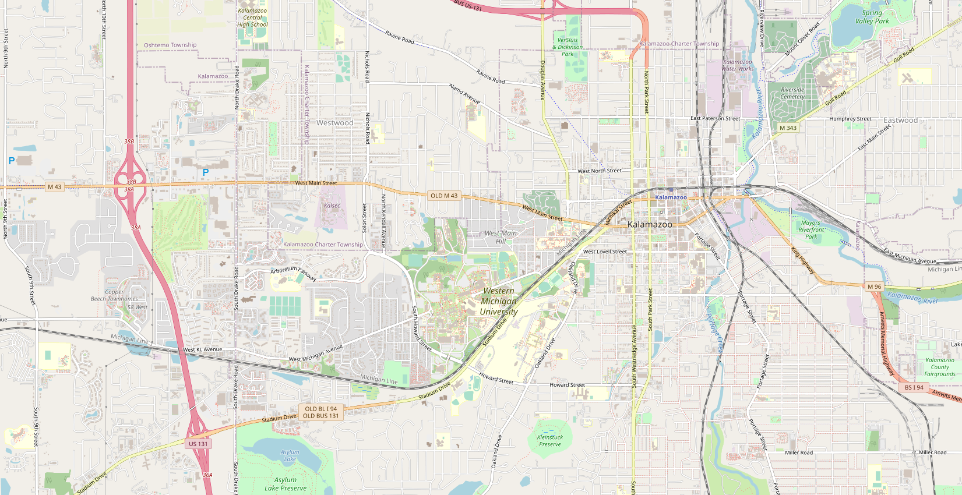
About the Project

Slide 3
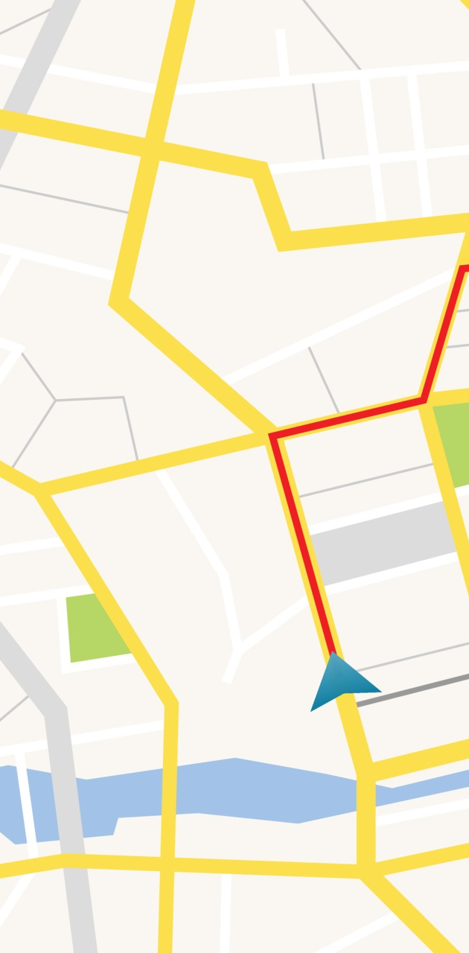
Navigational website for Kalamazoo and portage
Our Client has asked our group to make a custom navigational website for the people of Kalamazoo and Portage for getting to a location by either:
Walking
Bicycle
Bus

Slide 4

The group is currently making to make a check box system so that the user can select areas by the following:
Bus Stops
Bicycle Racks
Bars and Restaurants
Restrooms
Drinking fountains
Bike repair shops
Stores
Cafes
Book stores and public libraries
Etc…

Slide 5
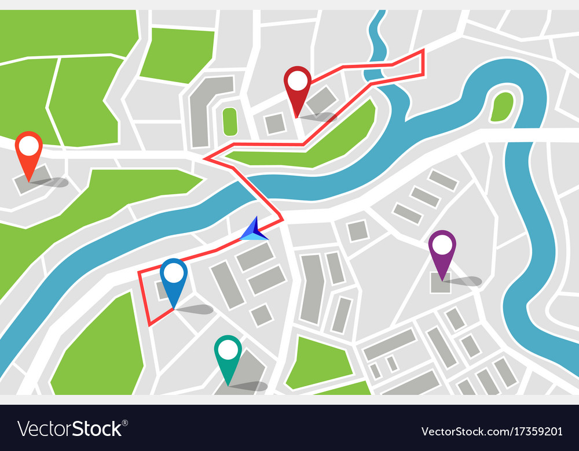
We are also using radio buttons for the ways a user wants to get to their location, from the following:
Walking
Biking
Walking and bus or biking and bus

Slide 6

The user also can select the road preferences, if there are preferable roads the user wants to travel on with a slider. The slider options include:
Biking favorability
Sidewalk favorability
Car Avoidance

Slide 7

Requirements

Slide 8
Functional Requirements:
The software shall plan a route for cycle/transit based on 2 nodes the user will enter on a map of Kalamazoo and Portage.
It shall use different data structures to store the necessary data collected from the user and stores the data retrieved from an open-source database.
It shall use a pathfinding algorithm with the data collected to compute either the shortest or most time efficient route.
The pathfinding algorithm will also consider the user input such as travel methods, road types, and amenities and will reroute the user if needed.
The software shall then display the route to the user via a line along the roads from start node to end node and will display turn-by-turn directions to the user.

Slide 9

User Interface Requirements:
The software shall display a map of Kalamazoo and Portage, and the user can interact with the map.
It has a navigation bar that can be opened on the left side of the window. It will have navbar will contain a radio button displaying transportation types, multiple sliders to dictate the favorability of certain types of roads, and a reset, about, and update buttons.
The UI shall allow the user to turn on and off layers via checkboxes, a button to export the directions to a CSV or GPX, a link to display a popup to the user that displays info about the page, and a reset link in the navbar that allows the user to start over and reset the web page back to the default settings.

Slide 10
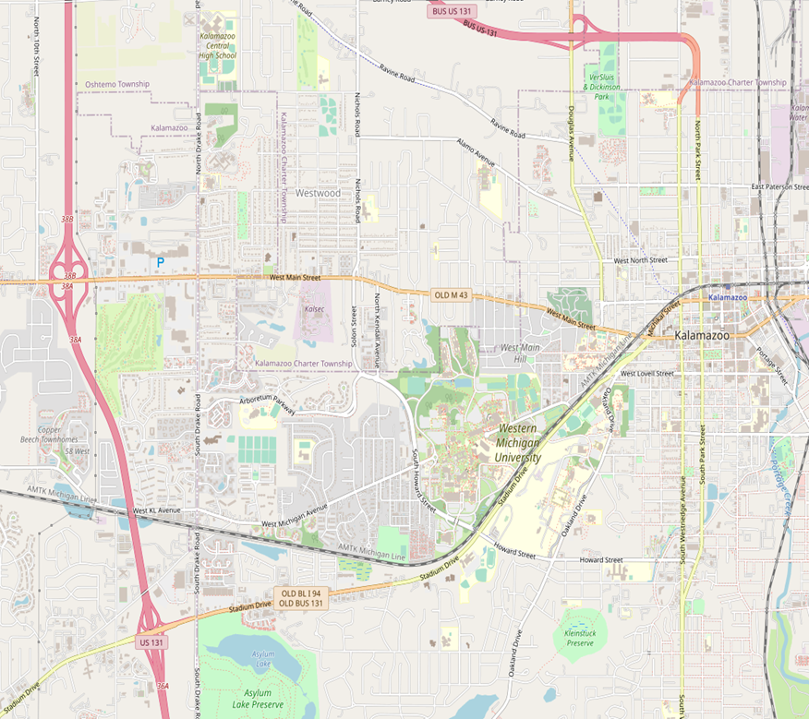
Capabilities Requirements:
The software shall take 15-30 seconds to plan and display and will run on chrome, firefox and safari.
The software shall also run on Apple and Android devices by having a responsive web page based on display size.
The database shall use less than 10GB of space.

Slide 11
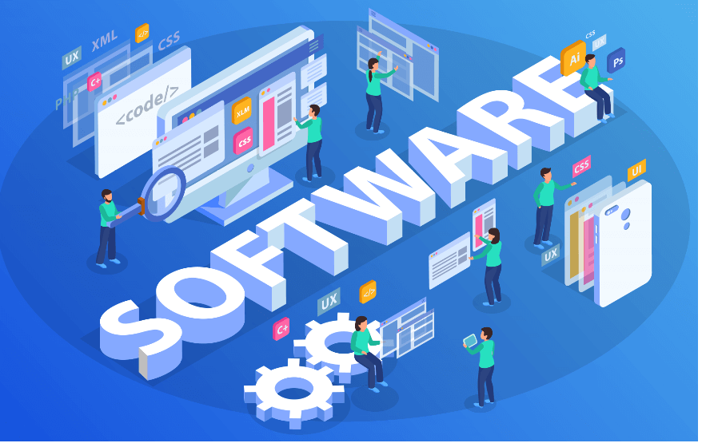
Software Interface Requirements:
The software shall connect to the Overpass API and connects and pulls data from OpenStreetMap (OSM).
A custom database shall be created and maintained in MySQL.
The user shall be able to export a GPX/CSV file that can be used as input into other mobile GPS apps.

Slide 12

Security Requirements:
The update tab shall open/lead to a web page asking for a security phrase in a text field box that needs to be entered by administrators.
The passphrase shall be encrypted with sha-256 and salt for extra encryption. This will be used to verify that the database is up to date.
The database itself will also have a username and password interface via a python script that runs a user interface for administrators to make changes to the database directly if needed.
The web page shall follow the https security protocols to protect the user's information and location.

Slide 13

Installation and Maintenance Requirements:
The software shall be installed on a server that will require routine maintenance and bug fixing.
The database shall be updated periodically by the update link on web page.
There shall also be a python script to interface with the database to change anything in the database if needed.

Slide 14

Current Plans

Slide 15

In the production line at the momement
Working on the routing between the two nodes
Currently working on the UI-design on the website
Fleshing out the security for the webpage
Figuring out which algorithm to use for routing the roads for between the two nodes
Keeping track of all bugs when working on the code, so we know to fix

Slide 16

Thank you
Any Questions?

